Slide 1
McStas Documentation and help sources
Main help resources
McStas website and info-links
The manual(s)
mcdoc
Mailing list + archive
GitHub Wiki
McStas review paper series (vol I and II are out)
The examples catalogue

Slide 2
McStas Documentation and help sources
Help resources prioritized
mcdoc
The examples catalogue
The manual(s)
McStas review paper series (vol I and II are out)
McStas website and info-links
GitHub Wiki
Mailing list + archive

Slide 3
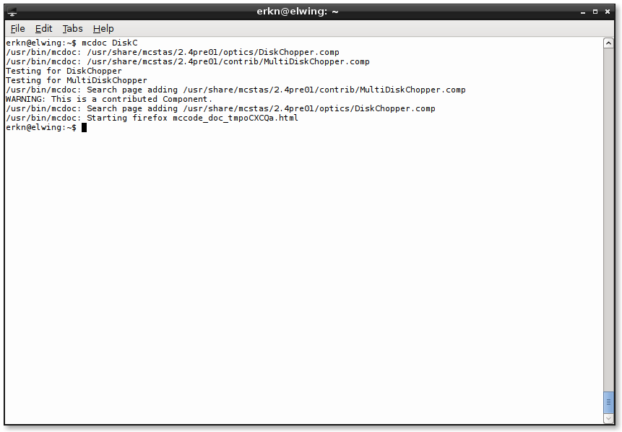
mcdoc
In a terminal:

Slide 4
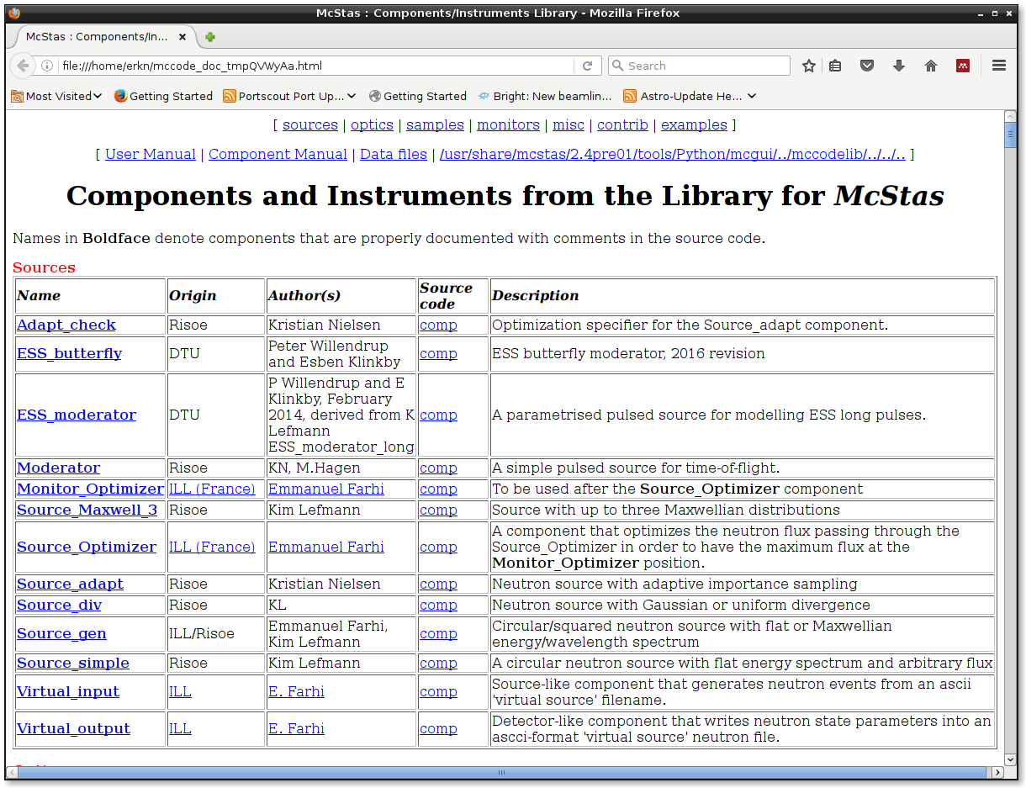
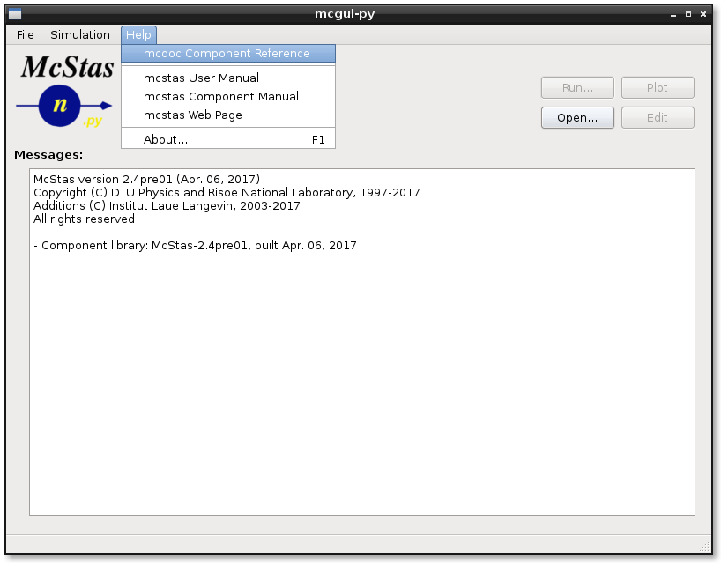
mcdoc
From the GUI

Slide 5
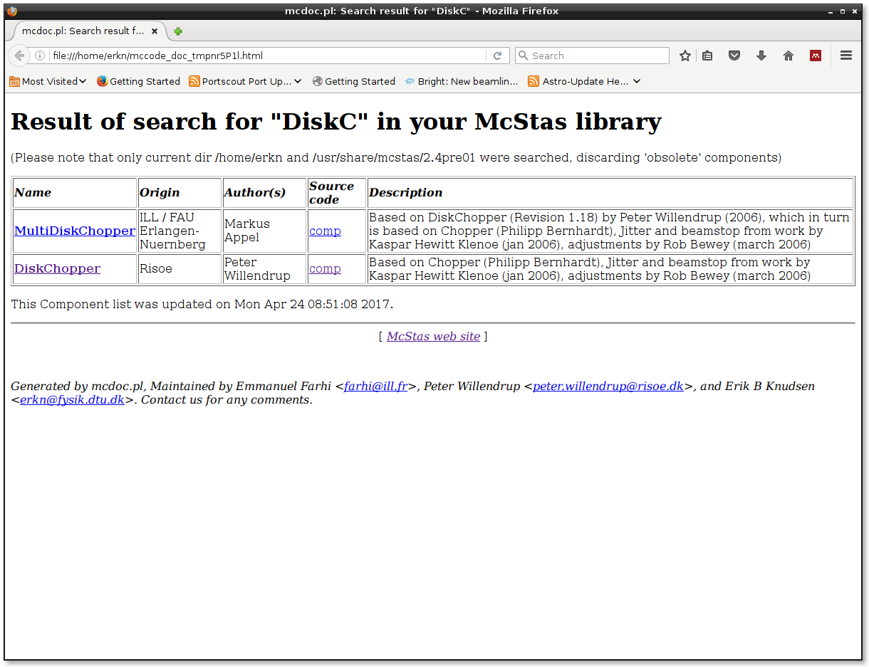
mcdoc DiskC
In a terminal

Slide 6
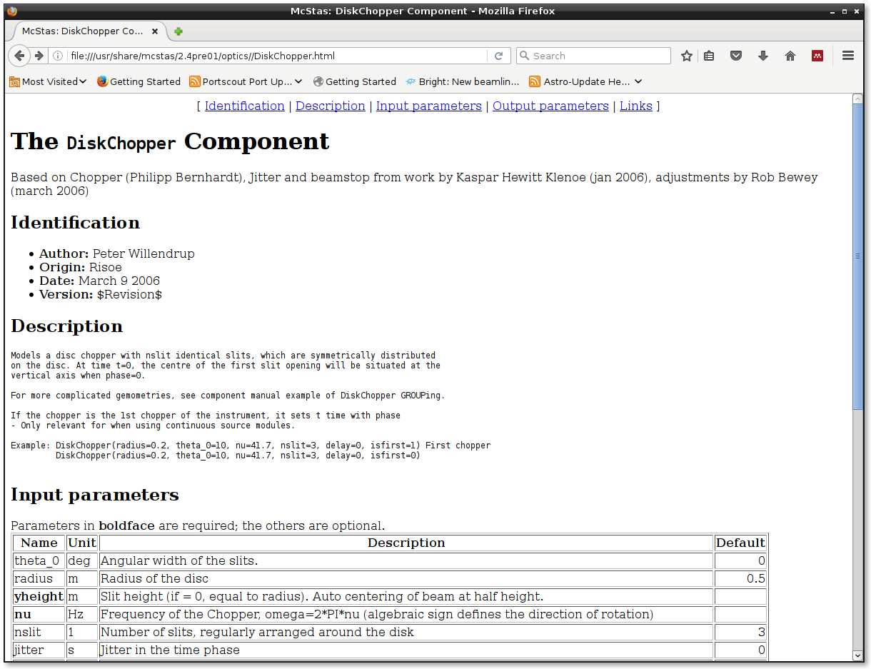
mcdoc
In a terminal

Slide 7
mcdoc
From the GUI

Slide 8
Examples Directory
Simple grep →
547 examples of Monitor_nD
64 examples of Source_gen
8 examples of ESS_butterfly
25 examples of MCPL I/O
25 examples of Single_crystal
Unix/Linux:
grep ESS_butterfly /usr/share/mcstas/3.0/examples/*

Slide 9
Examples Directory
Simple grep →
547 examples of Monitor_nD
64 examples of Source_gen
8 examples of ESS_butterfly
25 examples of MCPL I/O
25 examples of Single_crystal
They have an author name!
For instance:
ISIS_CRISP → R. Dalgliesh
SE_example → E. Knudsen

Slide 10
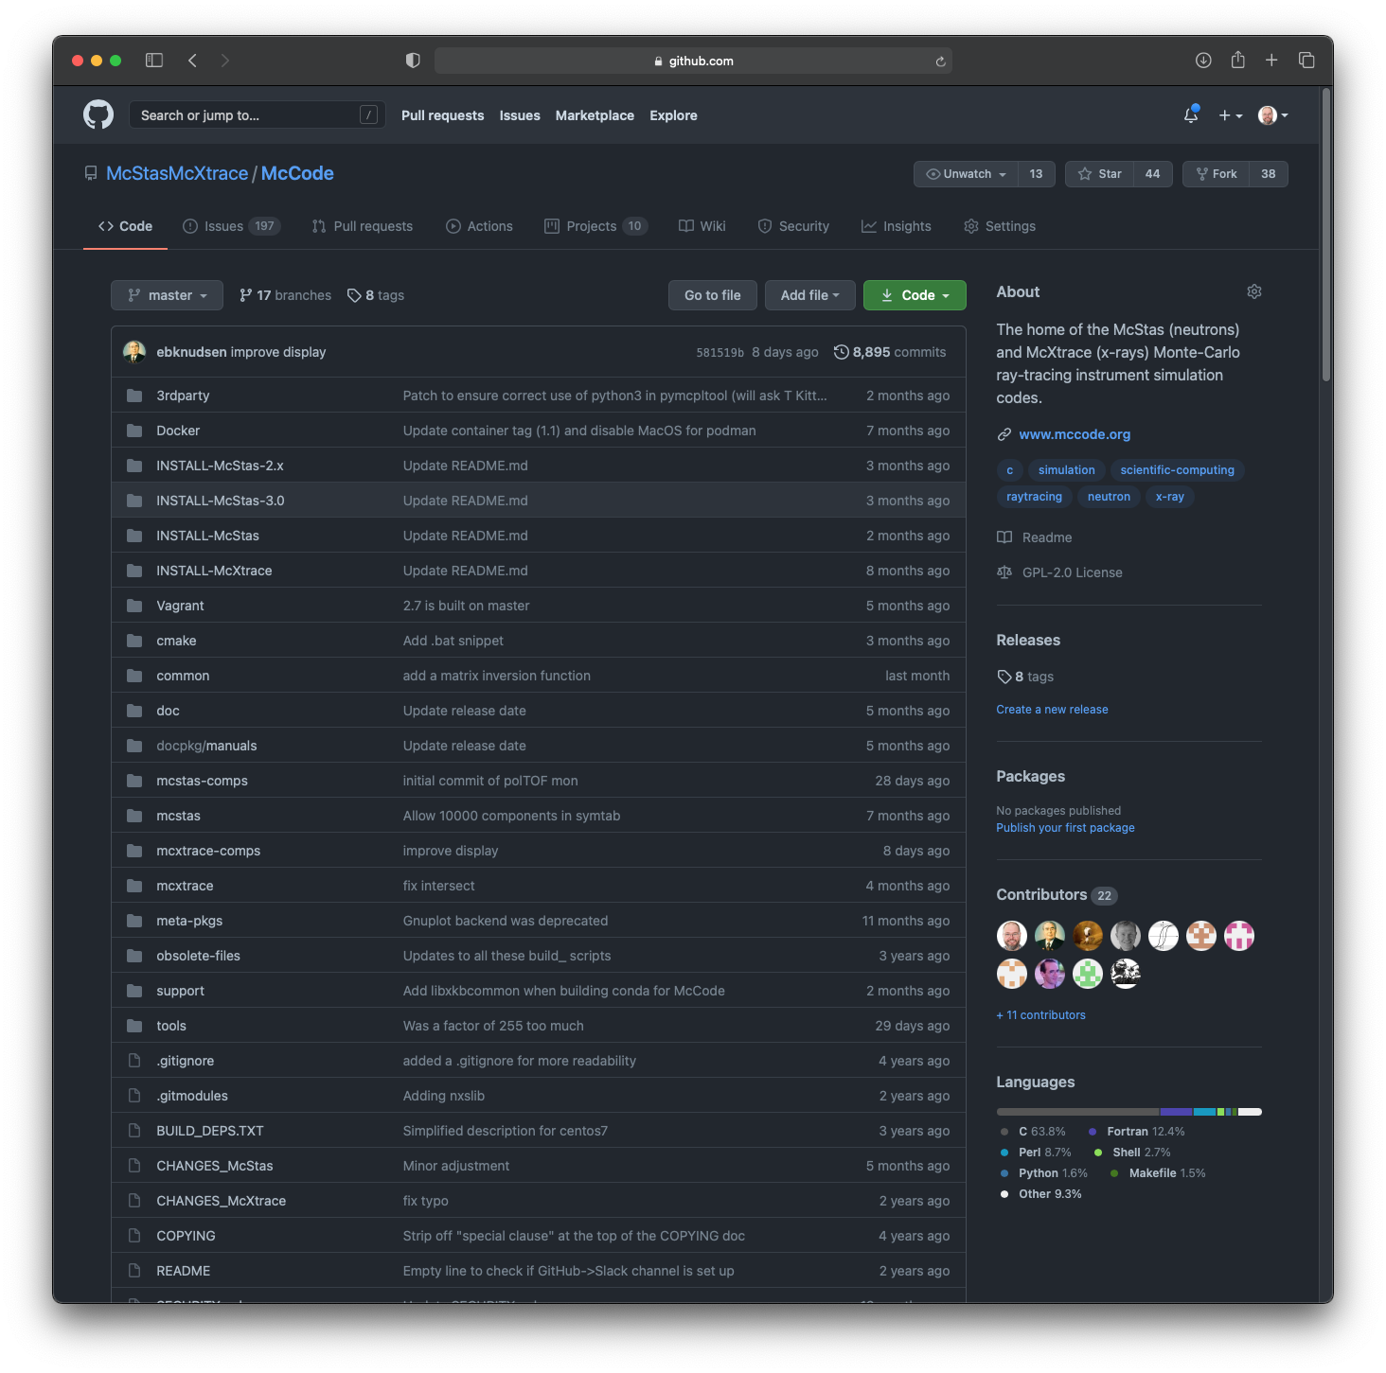
https://github.com/McStasMcXtrace/McCode

Slide 11
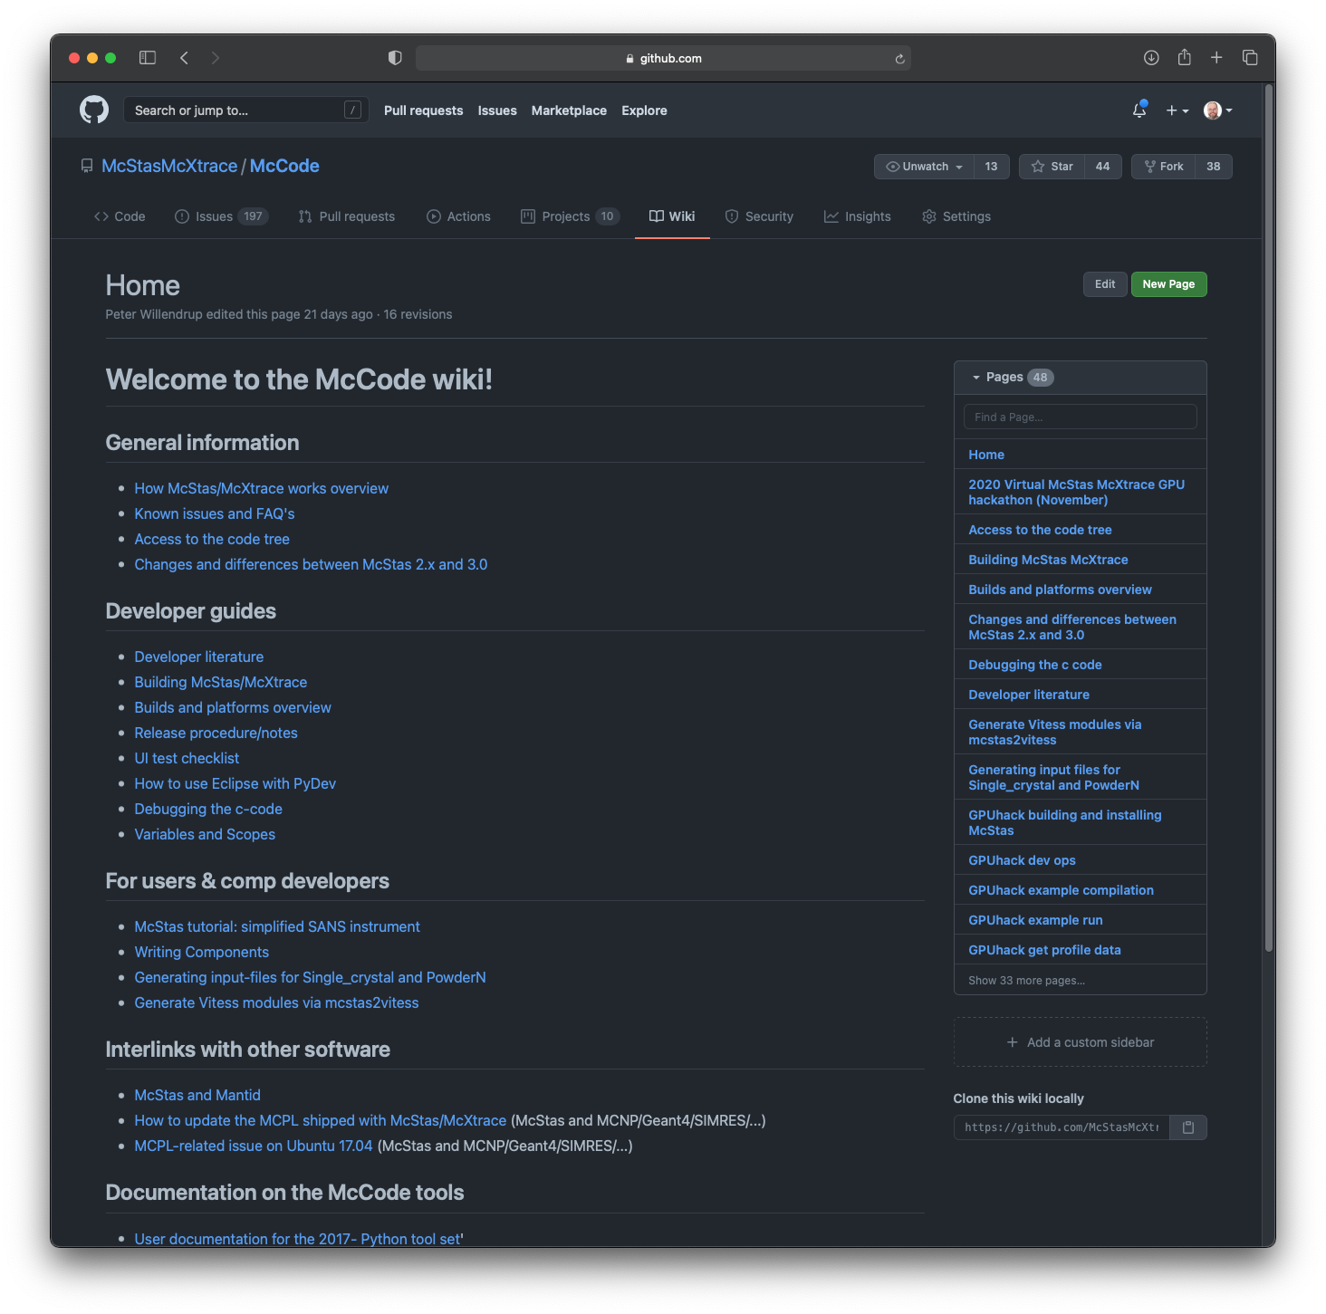
McCode Wiki on GitHub

Slide 12
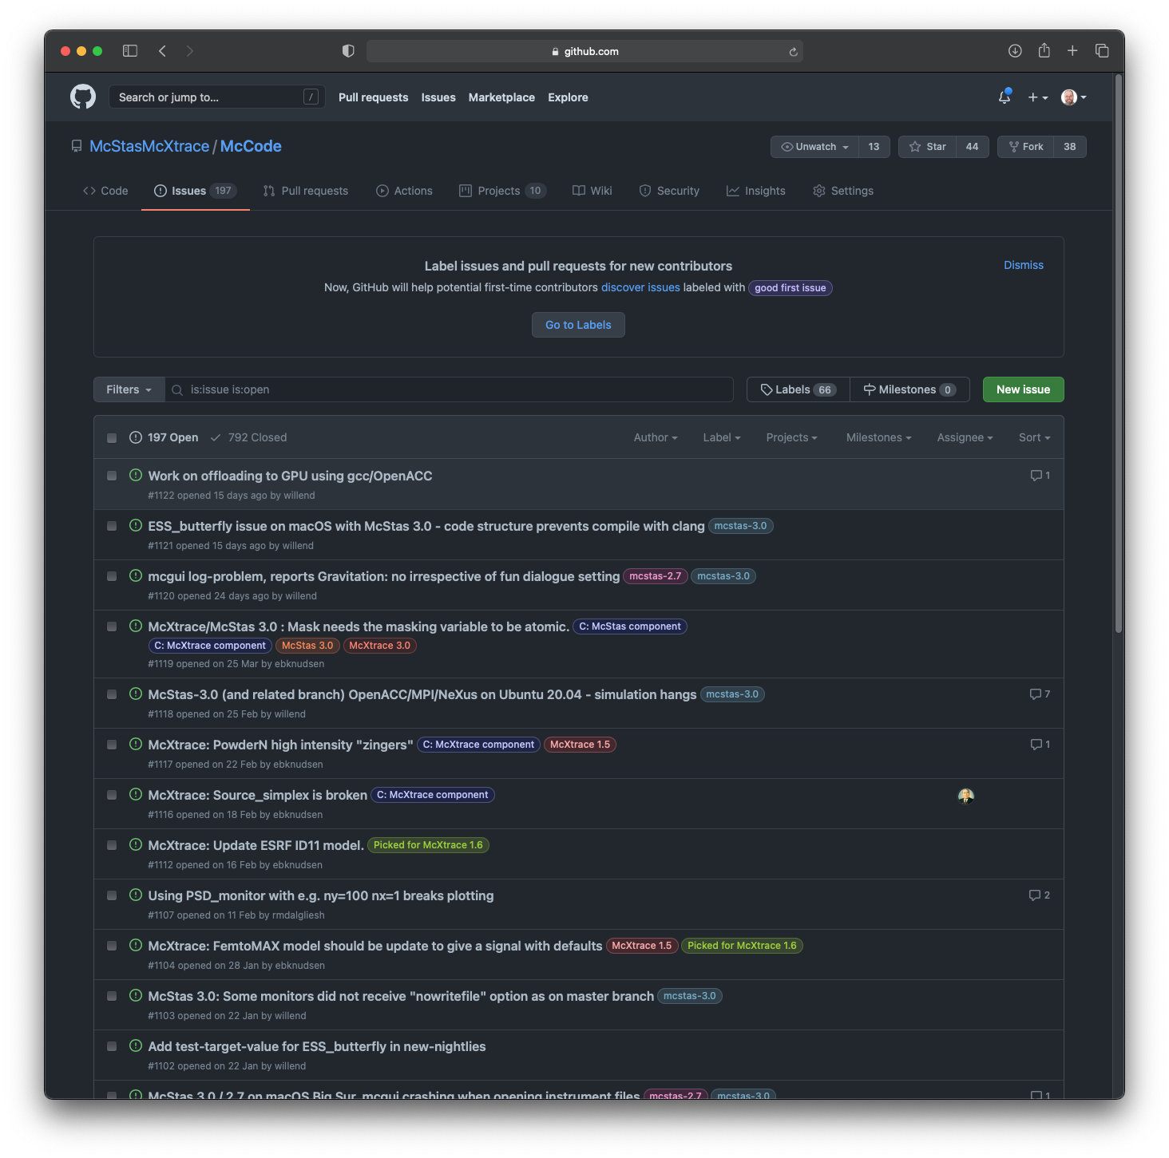
GitHub.com: Issue Tracker
Report here!

Slide 13
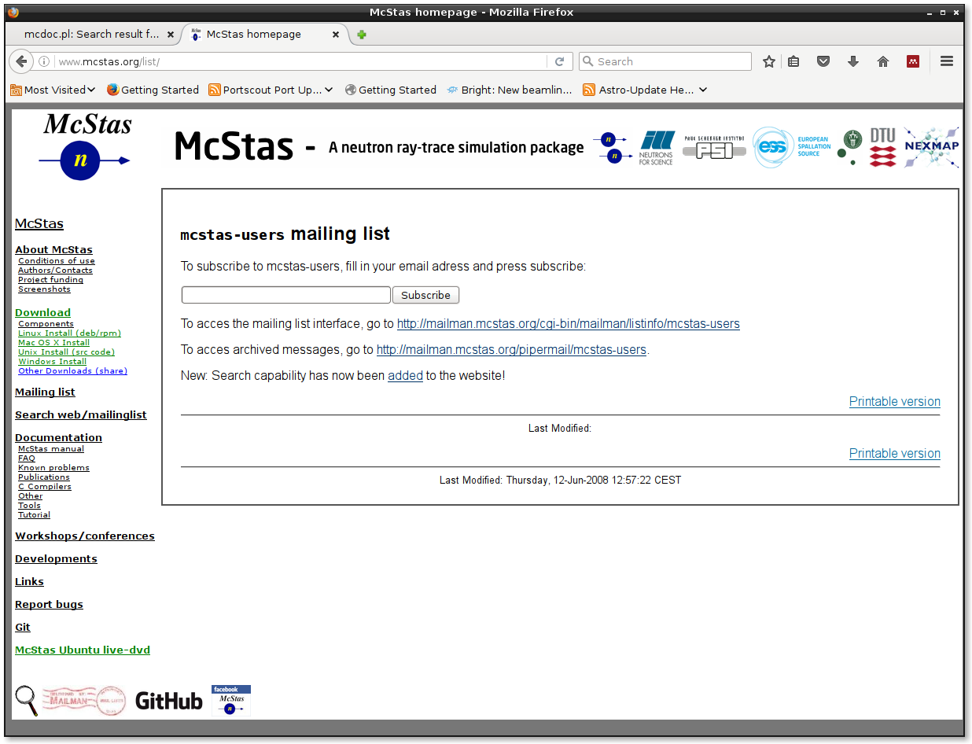
Mailing list, access via http://mcstas.org/list
Please subscribe!!

Slide 14
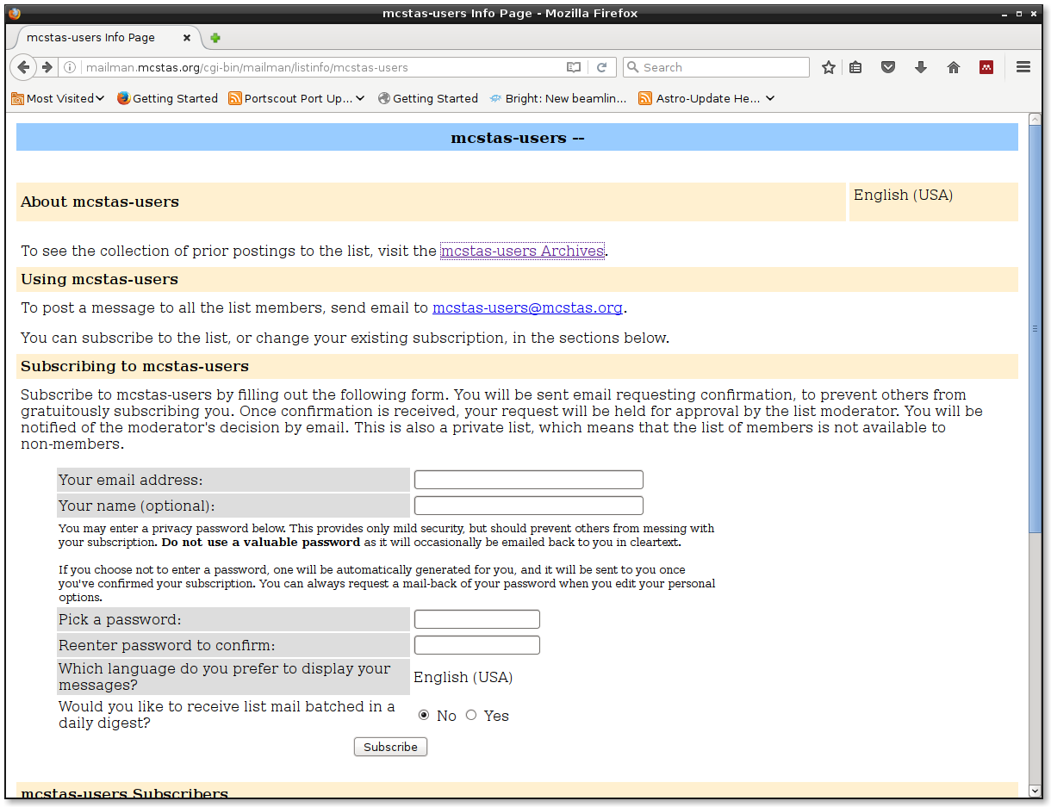
Mailing List mailman interface, access to Archives

Slide 15
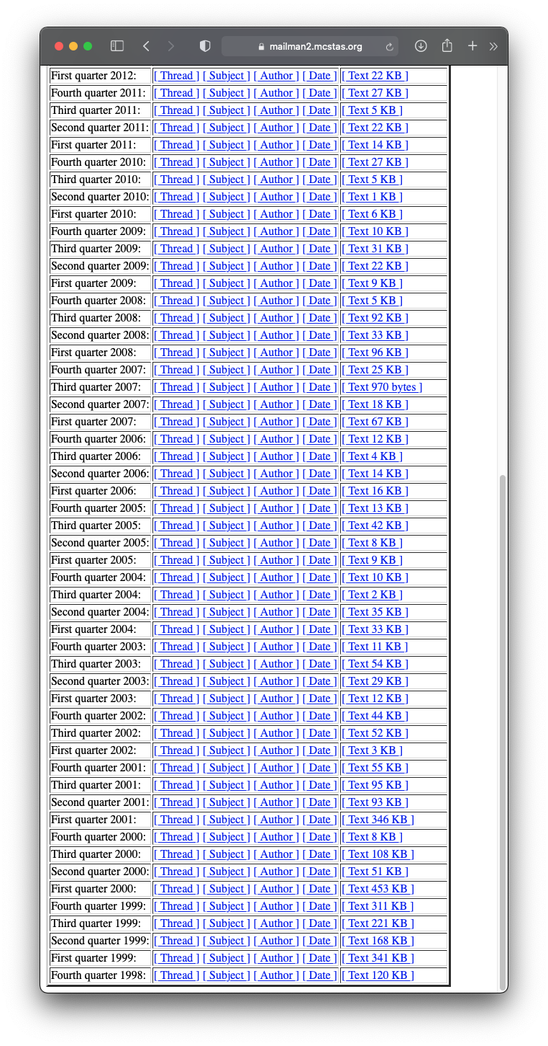
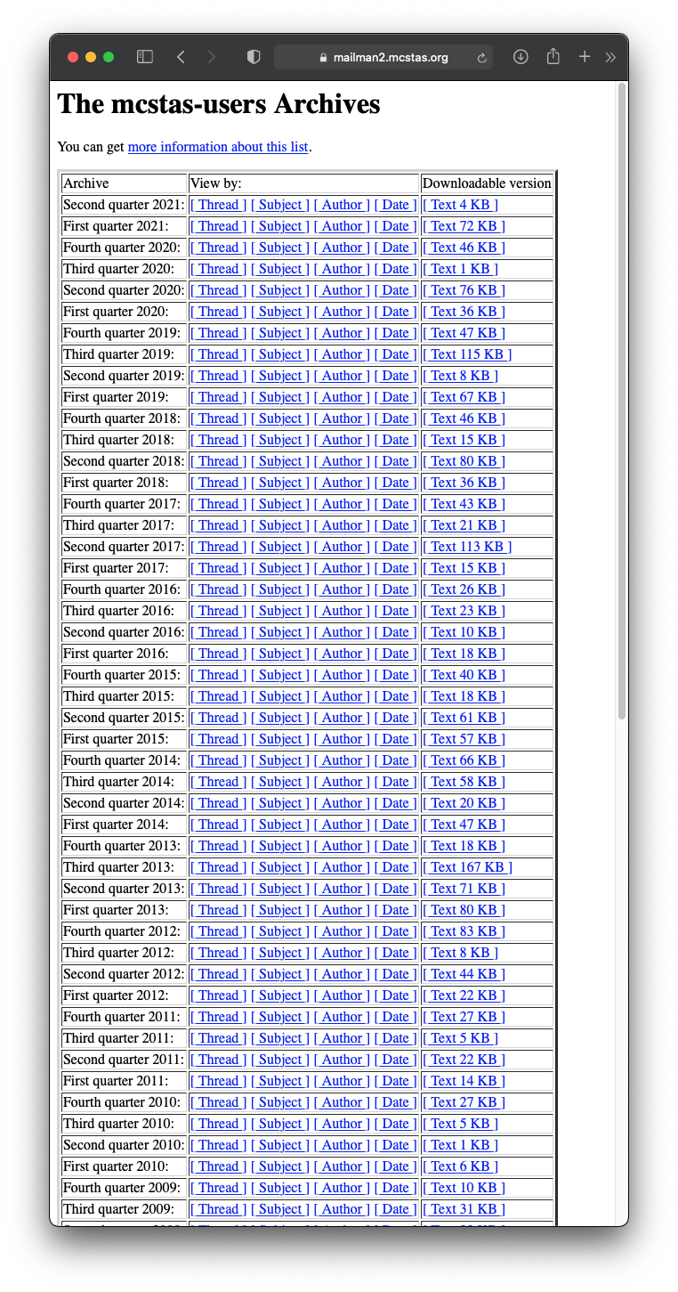
Mailing List - archive dates back to 1998…

Slide 16
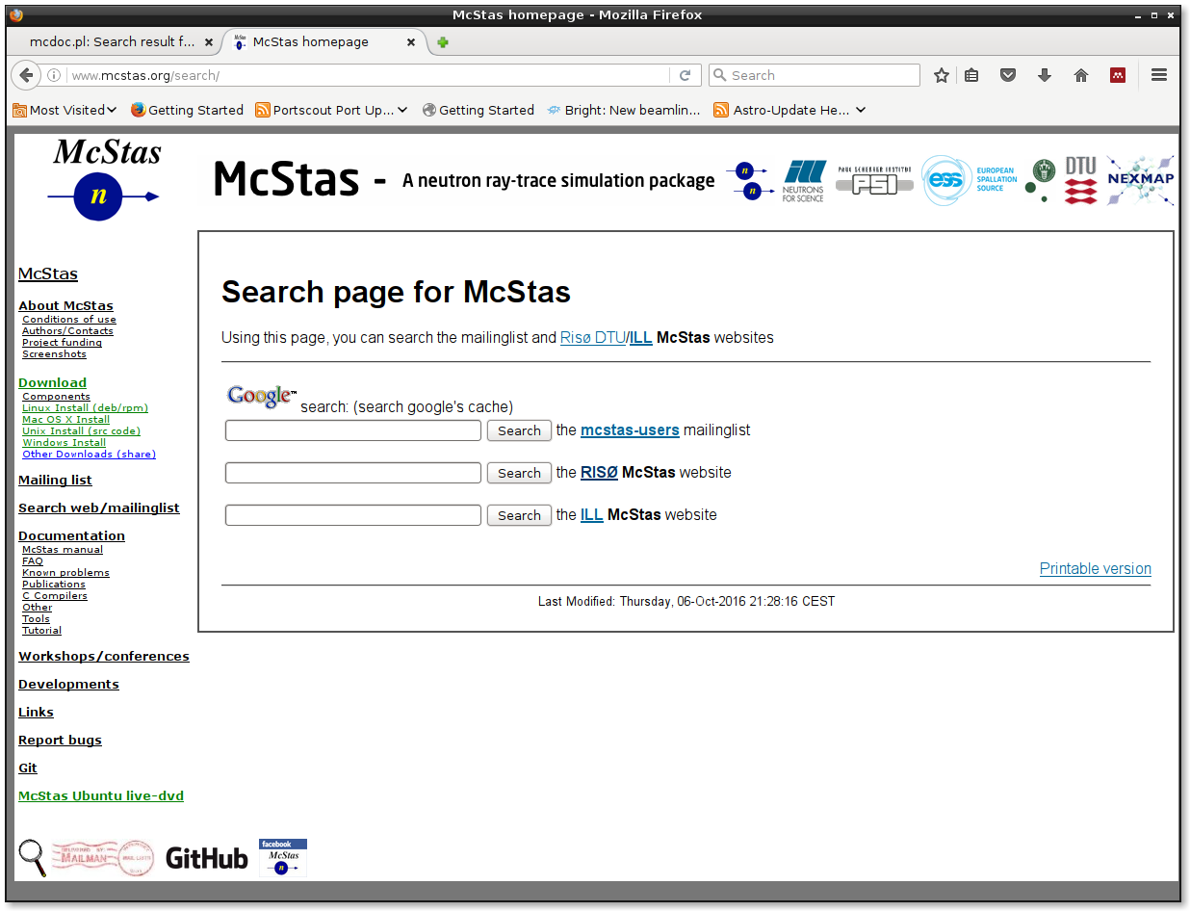
Mailing List Search page

Slide 17
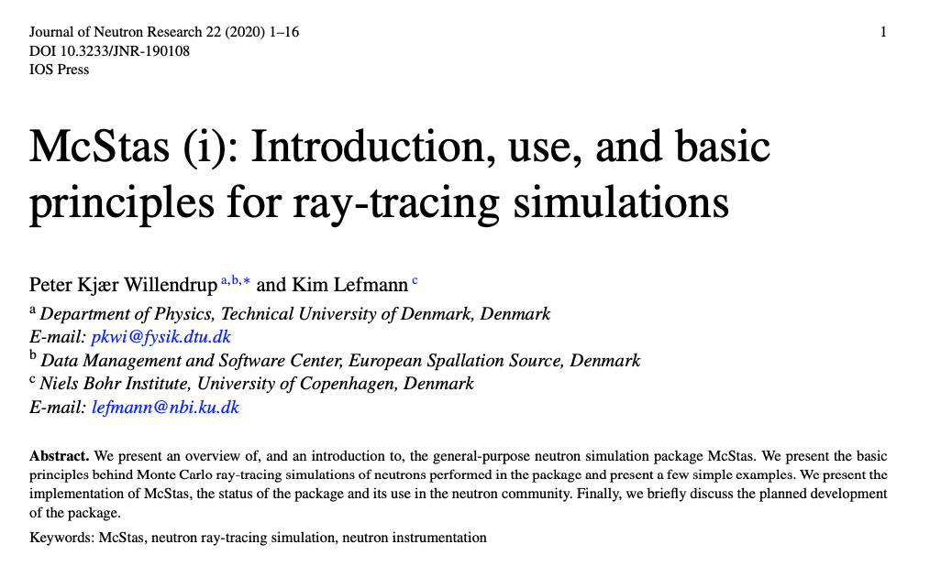
Newest “standard-refs” i,ii out of forthcoming series of vi

Slide 18
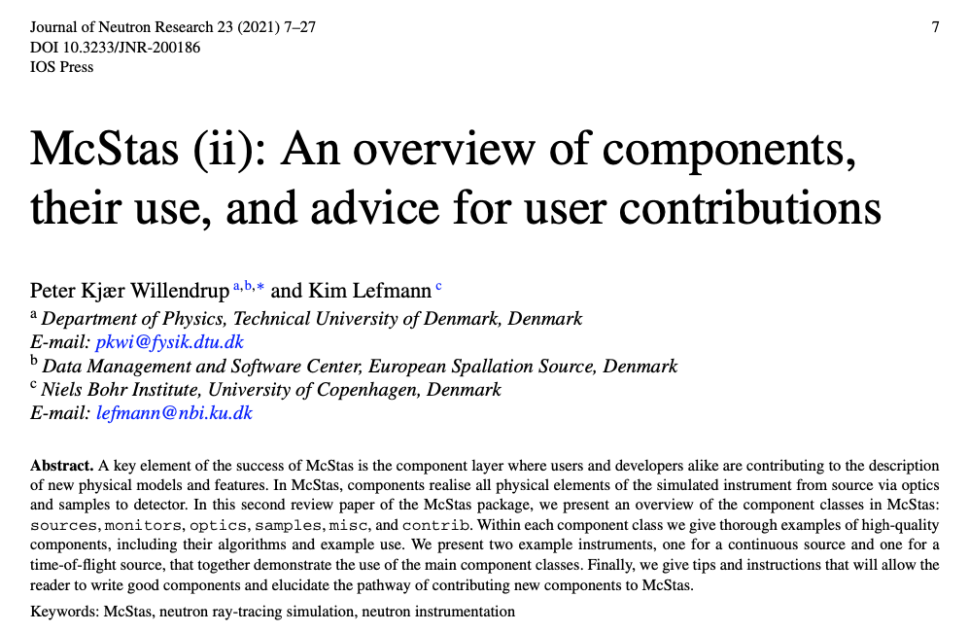
Newest “standard-refs” i,ii out of forthcoming series of vi

